Slide 1

Vrinda Store Annual Sales Report (2022)
Enhancing Customer Understanding for Substantial Growth in 2023

Slide 2
Introduction
In our quest for business growth, Vrinda Store embarked on a mission to comprehend its customer base and pave the way for increased sales in 2023. Armed with an extensive dataset for the year 2022, our focus shifted towards comprehensive analysis and visualization using the powerful tool - Microsoft Excel.
Objectives:
Understand customer behavior
Identify growth opportunities
Generate insights for strategic decisions in 2023

Slide 3

Data Overview
Raw Data Challenges Identified:
Inconsistent gender labels ('M' vs. 'Male', 'W' vs. 'Women')
Lack of clear age group distinctions
Dates in need of refinement for effective analysis
Data Cleansing Process
Regularizing Gender Labels:
'M' and 'Male' unified as 'Male'
'W' and 'Women' unified as 'Female'
Age Group Classification:
Utilized nested IF formulas to categorize ages into Adult, Senior, and Teenager groups.
Month Separation:
Extracted the month from the date column for time-based analysis.
Qty Column Standardization:
Replaced 'One' and 'Two' with numerical values '1' and '2'.

Slide 4
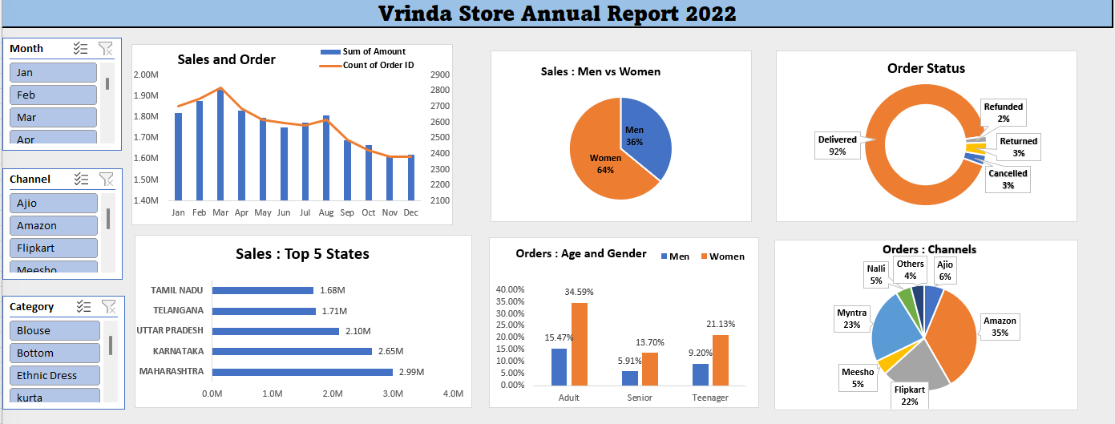
Excel Dashboard

Slide 5
FINDINGS
Sales vs Order
The highest sales of ₹1,928,066 were recorded in March, accompanied by 2,819
orders while November has the lowest sales of ₹1,615,356 with 2,384 orders.
Gender vs Order Amount
Women's orders accounted for ₹13,562,773 (64.05%) surpassing men's orders
₹7,613,604 (35.95%).
Order Status vs Order
The majority of orders were delivered (28,641 ), followed by returns (1,045),
cancellations (844), and refunds (517).
Top 10 States in Ordering
Maharashtra led in order amount with (₹2,990,221) followed by Karnataka
(2,646,358) and Uttar Pradesh (₹2,104,659)
Channels vs State
Amazon had the highest order count with (11,016) followed by Myntra (7,254) and
Flipkart (6,703).
Age Group vs Gender
Women dominated order placements across all age groups.
Order vs Channel in Percentage
Amazon consistently held the highest percentage of orders, followed by Myntra and Flipkart.

Slide 6
Suggestions to Improve Vrinda Store Sales
Leverage Success: Identify factors behind March's high sales for replication.
•Target Male Customers: Implement targeted marketing campaigns to increase male order amounts.
•Reduce Cancellations and Returns: Minimize cancellations, refunds, and returns through quality improvement and enhanced customer support.
•Focus on Top Ordering States: Enhance customer satisfaction and loyalty in Maharashtra, Karnataka, and Uttar Pradesh.
•Optimize Channel Performance: Allocate resources based on channel contributions, with a focus on Amazon, Myntra, and Flipkart.
•Foster Innovation and Agility: Encourage innovation, provide training, and promote data-driven decision-making.

Slide 7

Thank You

